Slide 1
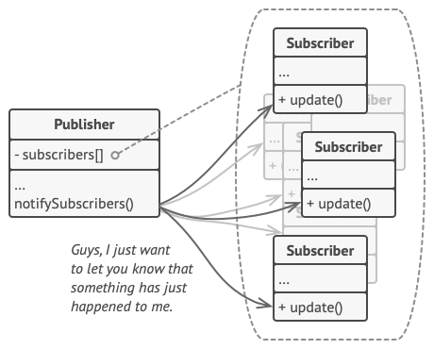
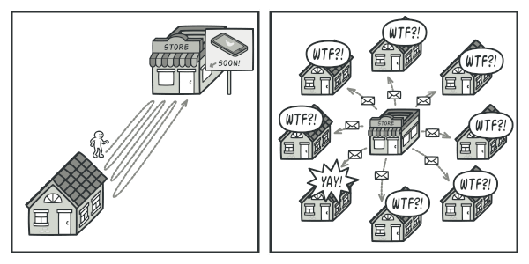

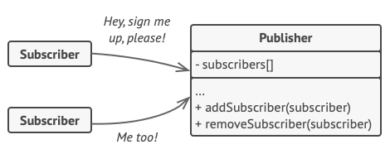
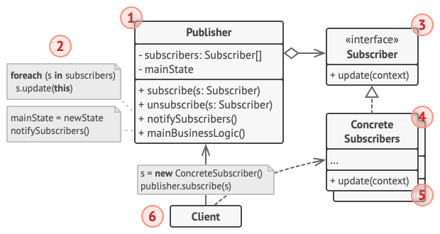
OBSERVER PATTERN
Intent
Observer is a behavioral design pattern that defines a subscription mechanism to notify multiple objects about any events that happen to the object they’re observing.
Motivation
Supposed that we have two types of objects: Customer and a Store.
The customer is very interested in a particular brand of product.
Problem:
The customer could visit the store every day and check product availability → most of these trips would be pointless.
the store could send tons of emails
Figure 1: Illustration of Observer pattern.
Application
Figure 2: How to save time and resources for both customer and store?
When changes to the state of one object may require changing other objects, and the actual set of objects is unknown beforehand or changes dynamically.
When some objects in our app must observe others, but only for a limited time or in specific cases
Solution
Pros and cons
Pros:
+ Support the principle of loose coupling between objects that interact with each other.
+ Allow sending data to other objects effectively without any change in the Subject or Observer classes.
+ Observers can be added/removed at any point in time
Cons:
- The Observer interface has to be implemented by concrete class, which involves inheritance.
- Allow The Observer can add complexity and lead to inadvertent performance issues.
Figure 3: A subscription mechanism lets individual objects subscribe to event notifications.
Figure 4: Structure of Observer Pattern.

